Slide 1

Visualizing ad campaigns
Group 12: Muhammad Salman, Naga Tejaswini Popuri, Abonti Ferdous, Atul Inamdar

Slide 2
INTRODUCTION
Our data set is concentrated towards Advertisement campaigns. There are specific mention of attributes such as date, tag, sub-type, type, rating, cost and predicted CTR. The rating component is subdivided into 3 respective categories—PG-13, PG-17, and R. The date, which features multiple specific dates spanning from 2022, operates as a demonstration of the temporal nature of the advertisement campaigns. The cost section is indicative of the necessary funds that are allocated towards each campaign. The tag, sub-type, and type components operate as categorical variables that define a variety of characteristics of the campaigns, itself.
In order to have a more holistic understanding of the data set, we utilized median and mode to grasp the central tendency of the attributes. We also focused on the different relationships that existed between each attribute, such as cost variation by relating cost to tag and type. An assortment of different visualizations were utilized to provide an in-depth look at the existing relationships.

Slide 3
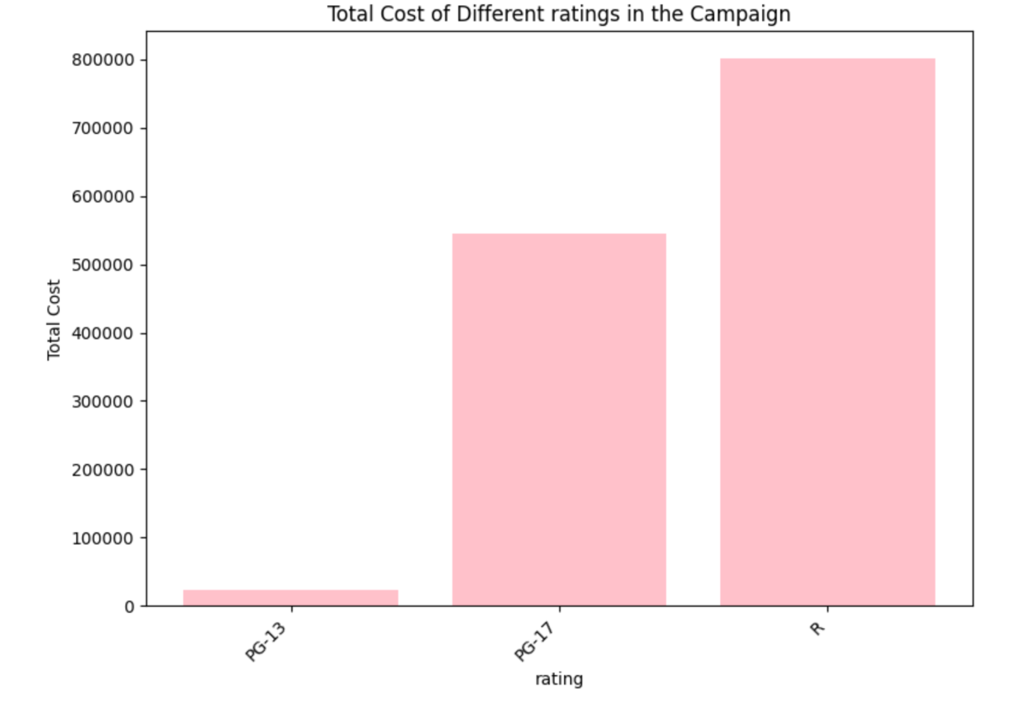
Bar Chart
Advertisement campaigns that are rated R have the most monetary funds concentrated towards their inception. Those rated PG-17 are intermediate, in relation to the total costs generated. PG-13 advertisement campaigns have the lowest total costs.
A possible theory can be that given is the significantly low total costs of the PG-13 advertisements, they are not a prolific part of the campaign. That is, there are fewer PG-13 advertisements that are produced.

Slide 4
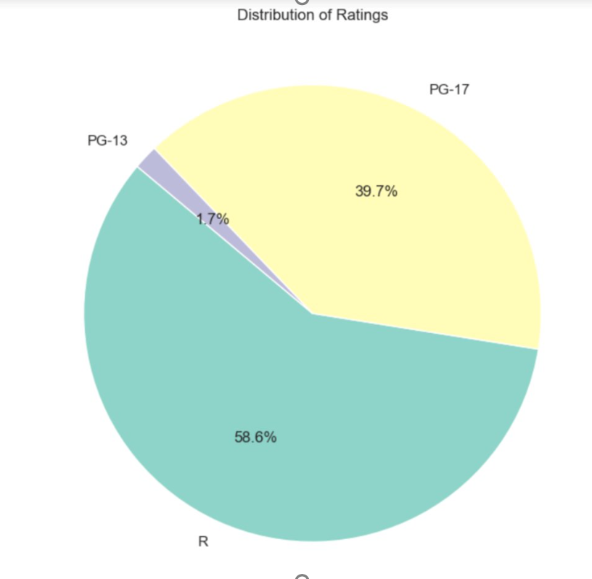
PIE CHART
The pie chart offers a visual representation of the distribution of ratings of the advertisement campaigns.
Each slice denotes a specific rating category – PG-13, PG-17, and R.
The greatest proportion of advertisement campaigns are rated R. Indeed, more than half of the data-set is rated R.
The lowest proportion is PG-13, denoting that PG-13 advertisement campaigns are not prolific and not produced as significantly.

Slide 5
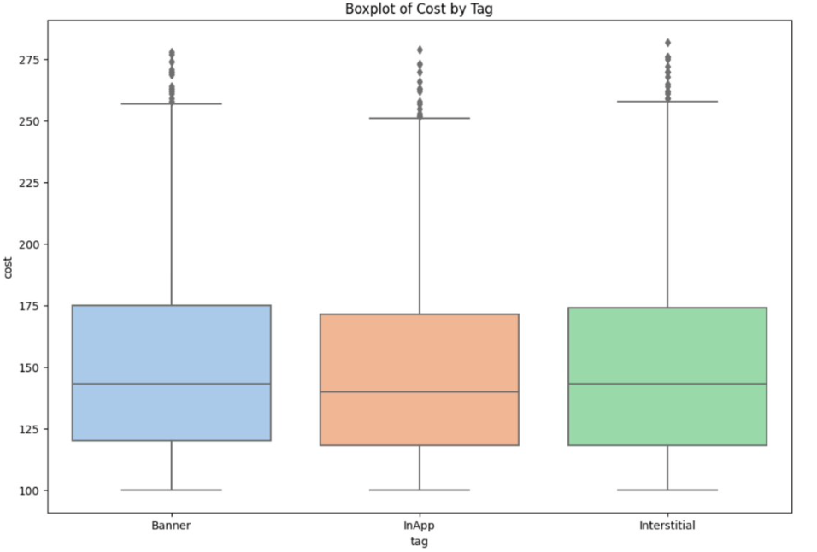
BOX PLOT
The box plot examines the relationship between the cost and the tag of the advertisement campaigns.
The median values of all three of the different tags, Banner, InApp, and Interstitial, fell under the costs of 125 to 150.
The cost of 'InApp' was slightly lower in relation to Banner and Interstitial.

Slide 6
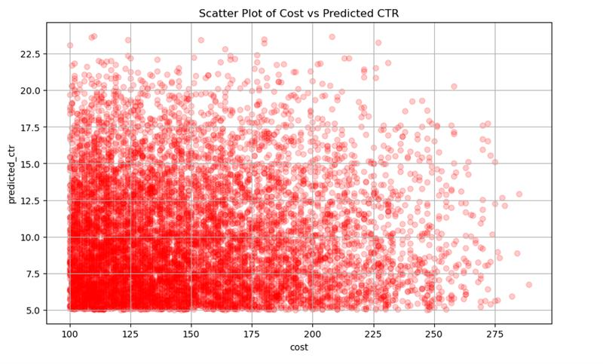
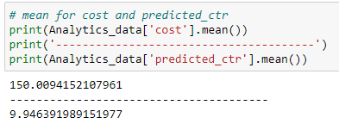
SCATTER PLOT
Predicted CTR is a likelihood a person will click on an ad. A high CTR means people will click on the ad.
In relation to our data set, it is noticed that heavy concentration of CTR is observed when cost is low.
High cost and low CTR may indicate ad is not very effective at driving clicks, or target audience is not interested in product being advertised.

Slide 7
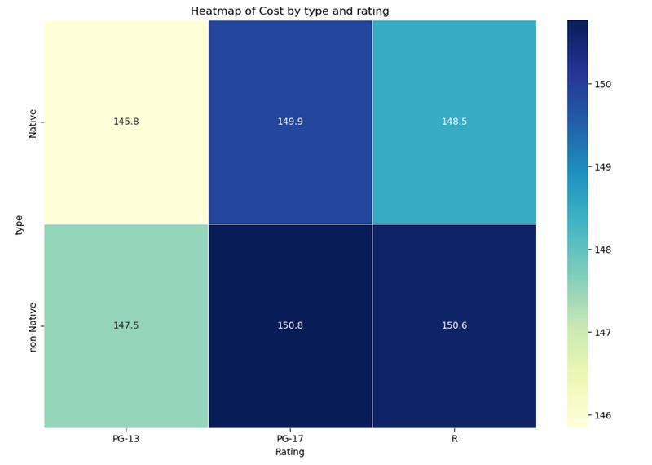
HEAT MAP
Based on the scale gradient of color produced in this heat map
The most expensive advertisement campaign would be the non-Native PG-17 advertisements.
The least expensive advertisement is the native PG-13 advertisement.
To conclude, the non-Native advertisements are more costly than the native advertisements.

Slide 8
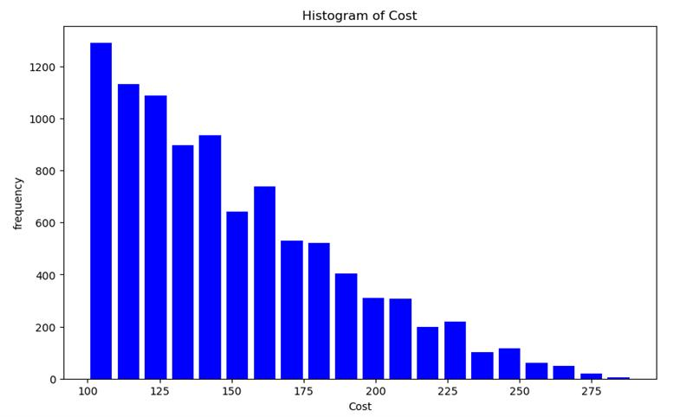
HISTOGRAM
The histogram is positively skewed, which is indicative of a right skewed distribution. As cost increases, frequency decreases.
Majority of the costs are on the lower end (primarily, where cost ranges from 100 to 140)
The tail proportion of the histogram is extended towards higher costs with low frequency.
High-cost outliers are present.
One can surmise that there is a greater production of ads that are lower in cost, versus those that are more expensive to produce.

Slide 9
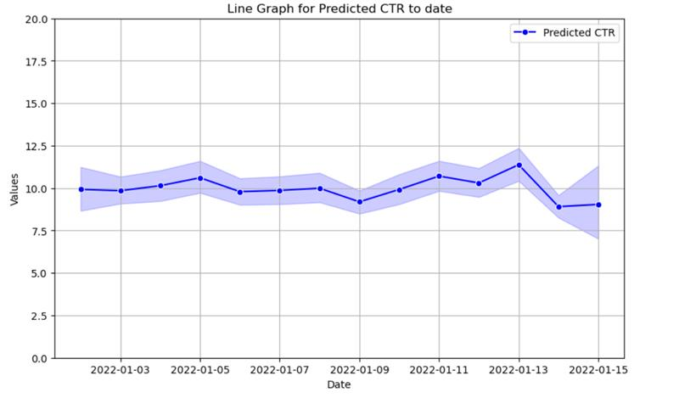
Line graph
This provides a visual representation of the expected performance of a campaign/advertisement strategy over a period of time; allows marketers to be proactive.
This operates as a demonstration of how the performance is not significantly dynamic. As the date progresses, the deviation in the Predicted CTR are very slight and minor.
Can aid in identifying particular patterns and performance tracking.

Slide 10
CONCLUSION
Advertisement campaigns are varied and consist of multiple complex relationships between its subgroups. By incorporating visualizations, we can obtain a better holistic understanding of the data-set in its entirety. We are also able to better grasp the relationships that exist between cost, ratings, type, and tags.
Advertisements that are rated R are the most prolific and consume the greatest amount of monetary funds. Contrastively, advertisements that are rated PG-13 are the least produced, and thus, generate the least amount of funds.
Also, non-native advertisements are typically more expensive than their native counterparts.
Visualizations are also instrumental in predicting anticipated trends and existing patterns. Through our line graph, we can conceptualize performance tracking and identify existing patterns among the predicted ctr. Visualizations allow the complexities of advertisement campaigns to be easily translatable and makes it easy to be discerned.

Slide 11
THANK YOU

